Slide 1
LDPC Codes and Tanner Graphs https://yair-mz.medium.com/decoding-ldpc-codes-with-belief-propagation-43c859f4276d
An Introductionto LDPC Codes
http://tuk88.free.fr/LDPC/ldpcchap.pdf
LDPC Overview
https://yairmz.github.io/LDPC/ldpc_overview/ldpc_overview.html

Slide 2
LDPC Codes and Tanner Graphs https://yair-mz.medium.com/decoding-ldpc-codes-with-belief-propagation-43c859f4276d
LDPC codes are a class of linear block error correction codes.
The codes are based on sparse parity check matrices, denoted by H.
The number of columns equals the block size.
The number of rows equals the number of check equations.
The matrix may be considered as a bi-adjacency matrix representing a bipartite graph.
These graphs are termed Tanner graphs.

Slide 3
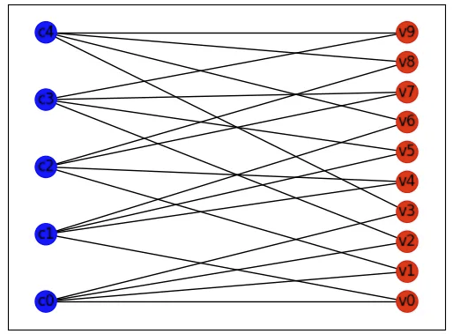
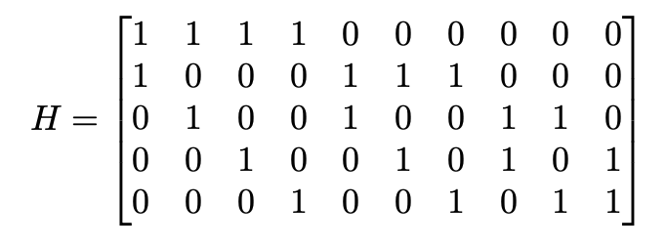
LDPC Codes and Tanner Graphs https://yair-mz.medium.com/decoding-ldpc-codes-with-belief-propagation-43c859f4276d
The two sets of nodes forming the graph are termed:
Check nodes (or c-nodes) with one node per row (or parity check equation).
Variable nodes (or v-nodes) with one node per column (one bit received from the channel).
The matrix H (n,j,k) :
The number of columns (n=10)
The same number of ones on each row (k=4)
The same number of ones on column (j=2)

Slide 4
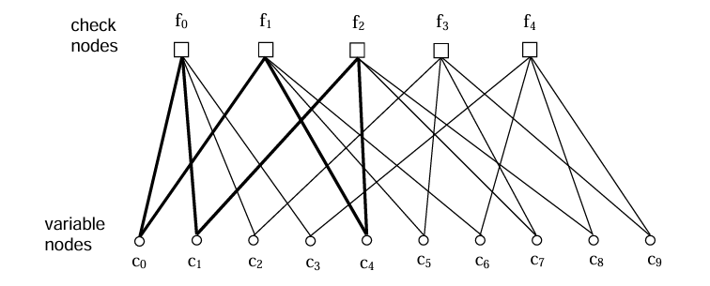
2. Representations of LPDC Codes 2.2 Graphical Representation http://tuk88.free.fr/LDPC/ldpcchap.pdf
Fig. 1. Tanner graph for example code.

Slide 5
Belief Propagation Message Passing https://yair-mz.medium.com/decoding-ldpc-codes-with-belief-propagation-43c859f4276d
The basic concept of the algorithm involves message passing.
Messages are passed iteratively between adjacent nodes (c-nods to v-nodes and vice versa) until convergence or an apriori dictated maximal number of iterations.
The nature of the messages involves probabilities or log-likelihoods of probabilities.
As nodes receive messages from their nearest neighbors, they improve their estimate regarding received bits.
posteriori 결과에서 원인을 분석해 들어가는, 귀납적인 (→a priori)
a priori 선험적인, 연역적인 (→a posteriori)

Slide 6
Belief Propagation Message Passing https://yair-mz.medium.com/decoding-ldpc-codes-with-belief-propagation-43c859f4276d
Since Tanner graphs for LDPC codes typically include cycles, the algorithm may not converge to the Maximum likelihood (ML) estimate.
MLE : maximizing a likelihood function so that, under the assumed statistical model, the observed data is most probable.
The point in the parameter space that maximizes the likelihood function is called the maximum likelihood estimate.
For sufficiently long blocks (large graphs), with sufficiently long cycles, the algorithm has been shown empirically to perform well.
posteriori 결과에서 원인을 분석해 들어가는, 귀납적인 (→a priori)
a priori 선험적인, 연역적인 (→a posteriori)
empirically 경험[실험]에 의거한, 실증적인

Slide 7
Belief Propagation Message Passing https://yair-mz.medium.com/decoding-ldpc-codes-with-belief-propagation-43c859f4276d
Another key feature is the passing of extrinsic information.
When a node passes a message to another, it uses information from all other neighbors to compose the message, but not information provided by the message recipient.
Since our graph contains two types of nodes, they will pass fundamentally different kinds of information in their messages.
Variable nodes pass messages that involve the log-likelihood of some bit being 0 or 1 by processing information obtained from other check nodes and the channel.
Check nodes pass messages which involve the log-likelihood of a parity equation is satisfied by processing information obtained from other variable nodes.
extrinsic (무엇에 원래 속한 게 아니라) 외적인[외부의]

Slide 8
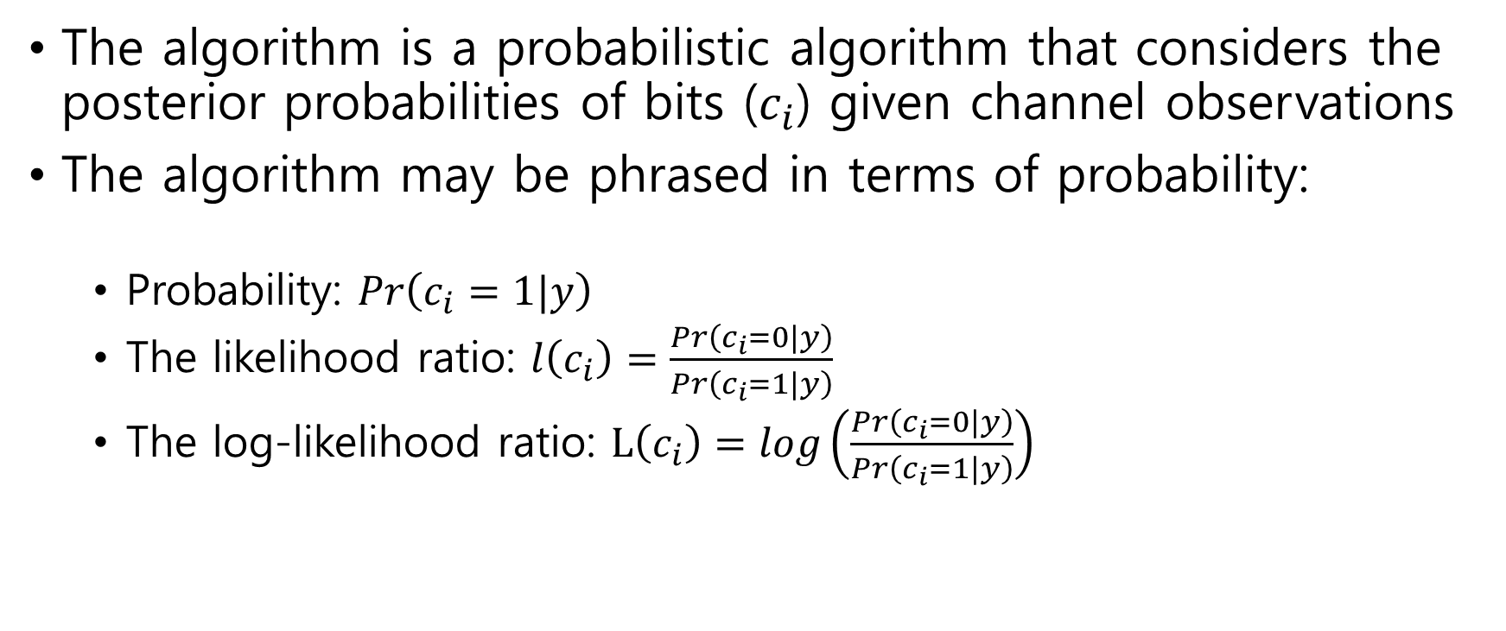
Belief Propagation Message Passing https://yair-mz.medium.com/decoding-ldpc-codes-with-belief-propagation-43c859f4276d
The algorithm is a probabilistic algorithm that considers the posterior probabilities of bits ($c_{i}$) given channel observations
The algorithm may be phrased in terms of probability:
Probability: $Pr\left(c_{i}=1|y\right)$
The likelihood ratio: $l\left(c_{i}\right)=\frac{Pr\left(c_{i}=0|y\right)}{Pr\left(c_{i}=1|y\right)}$
The log-likelihood ratio: $L\left(c_{i}\right)=log\left(\frac{Pr\left(c_{i}=0|y\right)}{Pr\left(c_{i}=1|y\right)}\right)$

Slide 9

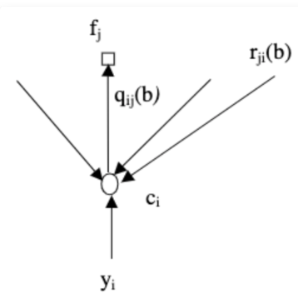

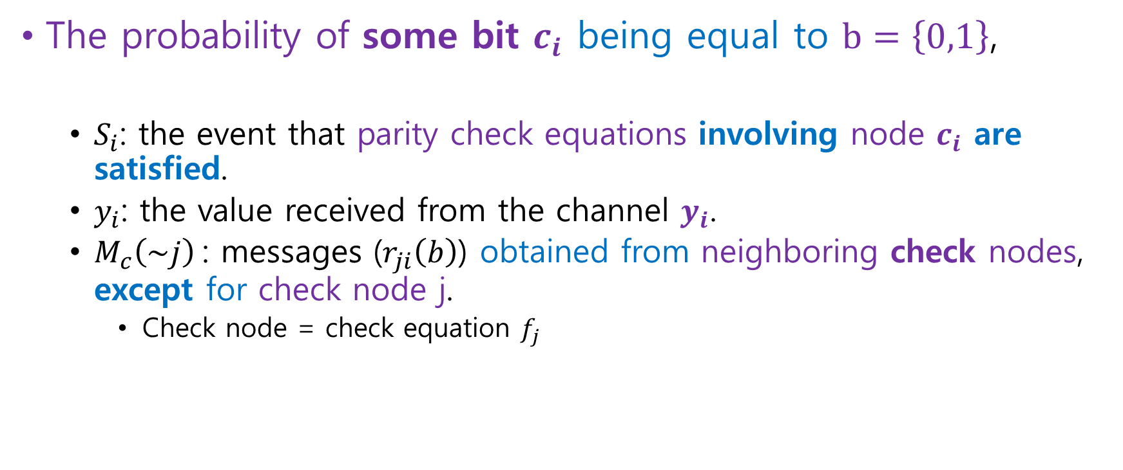
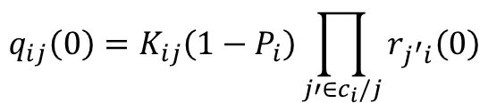
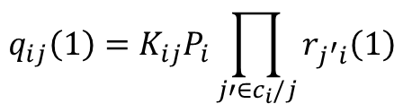
Probability and Likelihoods https://yair-mz.medium.com/decoding-ldpc-codes-with-belief-propagation-43c859f4276d
The probability of some bit $c_{i}$ being equal to $b=\left\{0,1\right\}$,
$S_{i}$: the event that parity check equations involving node $c_{i}$ are satisfied.
$y_{i}$: the value received from the channel $y_{i}$.
$M_{c}\left(\sim j\right)$: messages ($r_{ji}\left(b\right)$) obtained from neighboring check nodes, except for check node j.
Check node = check equation $f_{j}$
$$K_{ij}=q_{ij}\left(0\right)+q_{ij}\left(1\right)$$
$$q_{ij}\left(0\right)=K_{ij}\left(1−P_{i}\right)\prod_{j′∈c_{i}/j}{r_{j^{′}i}\left(0\right)}$$
$$q_{ij}\left(1\right)=K_{ij}P_{i}\prod_{j′∈c_{i}/j}{r_{j^{′}i}\left(1\right)}$$

Slide 10
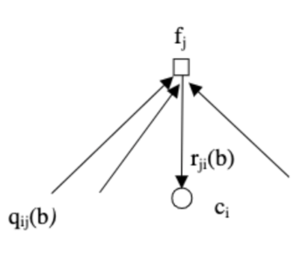


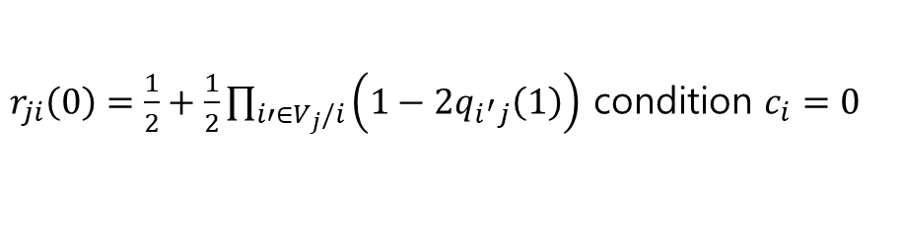
Probability and Likelihoods https://yair-mz.medium.com/decoding-ldpc-codes-with-belief-propagation-43c859f4276d
The probability of the j-th check equation to be satisfied,
It must contain an even number of 1’s.
$M_{v}\left(\sim i\right)$: the messages ($q_{ij}\left(b\right)$) received from all variable nodes except the variable node i.
$r_{ji}\left(0\right)=\frac{1}{2}+\frac{1}{2}\prod_{i′∈V_{j}/i}{\left(1−2q_{i^{′}j}\left(1\right)\right)}$ condition $c_{i}=0$
$$r_{ji}\left(1\right)=1−r_{ji}\left(0\right)$$

